Slide 1
SECURE DATA HIDING IN IMAGES USING STEGaNOGRAPHY
CAPSTONE PROJECT
Presented By: Kritika Kori
Student Name : Kritika Kori
College Name & Department : KJ College of Engineering and Management Research Pune , Computer Department

Slide 2
OUTLINE
Problem Statement
Technology used
Wow factor
End users
Result
Conclusion
Git-hub Link
Future scope

Slide 3
Problem Statement
In today’s digital era, securing sensitive information is crucial due to the rise in cyber threats.
Traditional encryption methods make data unreadable but also attract attention, making them vulnerable to interception.
Steganography provides a solution by hiding secret messages within images, ensuring covert communication without raising suspicion.
This project focuses on implementing image-based steganography using Python and OpenCV, allowing users to securely embed and retrieve messages from images while maintaining their visual integrity.

Slide 4
Technology used
Python → Core programming language
OpenCV → Image processing
NumPy → Array manipulation
OS Module → File handling
Image Format: PNG (prevents data loss due to compression)
VSCODE → for execution of code

Slide 5
Wow factors
✅ Invisible Communication → No one suspects an image contains a secret message.
✅ Password Protection → Only authorized users can decrypt the message.
✅ No External Storage Required → Data is embedded within the image itself.
✅ Lightweight & Fast → Works efficiently without complex encryption algorithms.

Slide 6
End users
🔹 Journalists & Activists → Secure communication in restricted areas.
🔹 Government & Military → Covert messaging for intelligence operations.
🔹 Cybersecurity Professionals → Protecting sensitive information.
🔹 Artists & Copyright Holders → Digital watermarking for ownership protection.

Slide 7
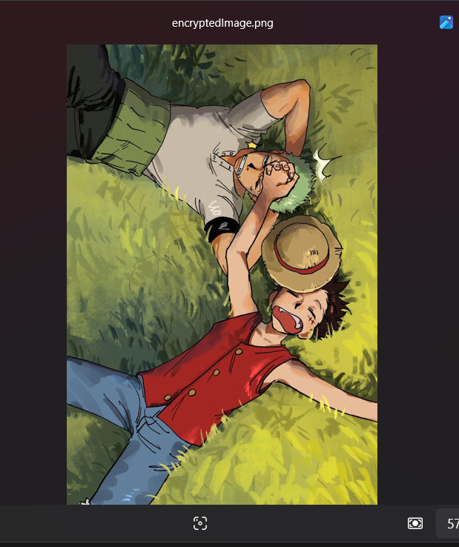
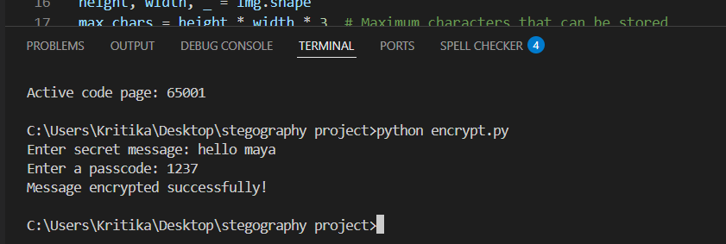
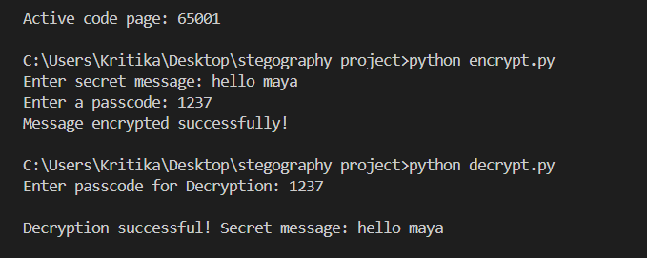
Results

Slide 8
Conclusion
This project successfully demonstrates how image steganography can be used to securely hide and retrieve secret messages within images using Python and OpenCV.
The implementation ensures that the image remains visually unchanged while embedding the data.
By adding password protection, only authorized users can access the hidden message, enhancing security.
In the future, this approach can be improved with encryption techniques and extended to audio and video steganography for broader applications.

Slide 9
GitHub Link
https://github.com/kritzxd8/Steganography-project-.git

Slide 10
Future scope(optional)
🚀 Improved Security: Use AES/RSA encryption before embedding the message.
🚀 Audio & Video Steganography: Expand beyond images.
🚀 Cloud-Based Implementation: Secure online steganography tools.
🚀 Mobile App Development: Android/iOS apps for easy steganography.

Slide 11
THANK YOU

